Slide 1
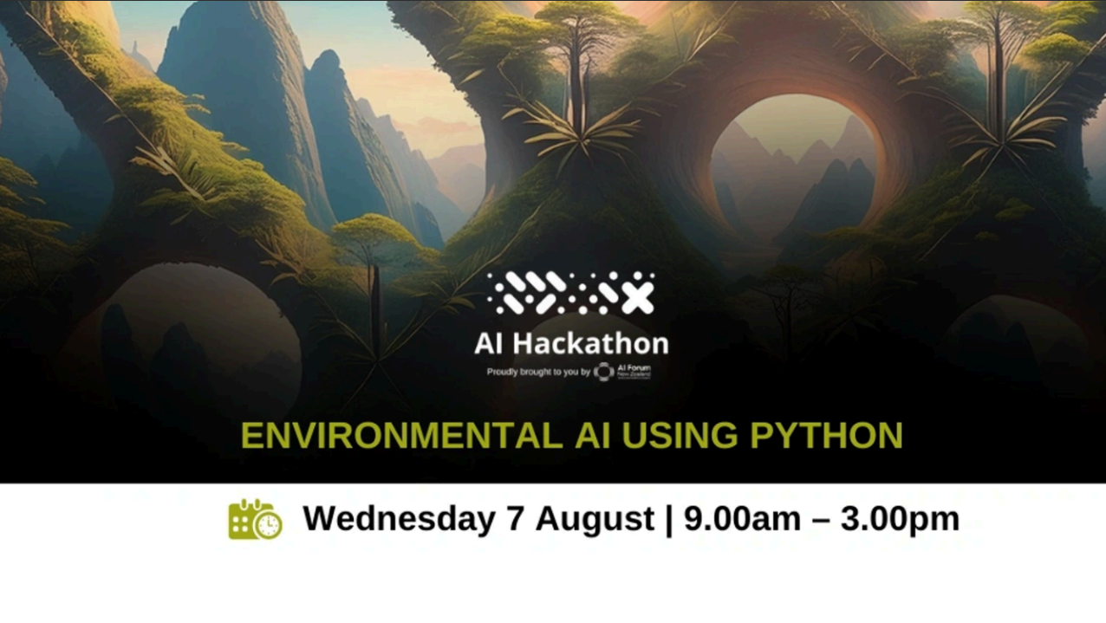

Slide 2
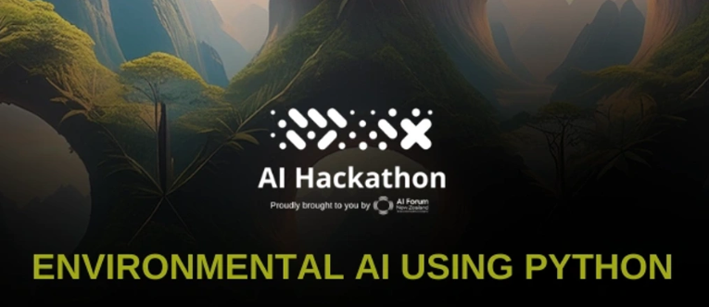
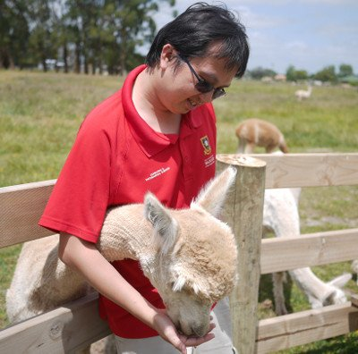
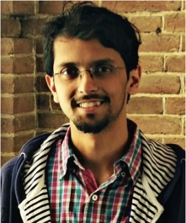
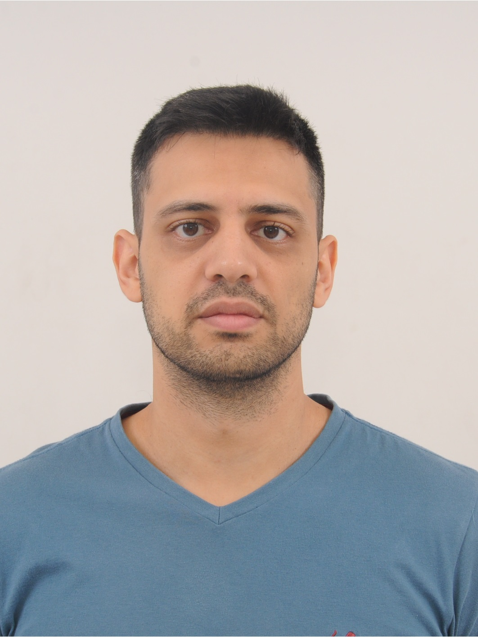
Good Day, I am Nick Lim,
My research focuses on explainable AI for time series and computer vision. In my free time, I dabble into photography and tinkering with electronics.
Good day, I am Anany Dwivedi
My research focuses on control of robotic and prosthetic devices using muscle-machine interfaces. In my free time, I like to learn to cook food from different cuisines.
Good Day, I am Guilherme Weigert Cassales
My research focuses on Data Streams and Time Series, specifically, I am interested in Anomaly Detection, Forecasting, and designing efficient algorithms. In my free time, I am the personal slave of a bossy 2-year-old girl.

Slide 3
Agenda for today
Session 1: Introduction
Introduction with Jupyter Notebooks and Google Colab
Handling common Python error messages
Session 2: Processing Data with Pandas
Using Pandas on Time Series Data
Session 3: Simple Machine Learning with Scikit Learn
Regression
Classification
Session 4: Simple Neural Networks with Keras
Simple Image classification

Slide 4
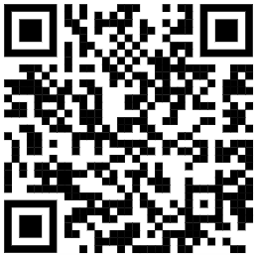
Introduction to Jupyter Notebooks and Colab
https://shorturl.at/RDJfJ

Slide 5
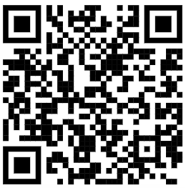
Handling Python errors
https://shorturl.at/rYQd3

